Slide 1

Course Name : Physics for Engineers
Course code : SPHA1101
Unit II : Physics of Solids
Handled by
Dr. D. S. Jayalakshmi
Assistant Professor,
Department of Physics,
School of Science and Humanities

Slide 2

Units
BASIC QUANTUM PHYSICS
PHYSICS OF SOLIDS
MAGNETISM,LASER FUNDAMENTALS AND OPTO ELECTRONICS
THERMAL PHYSICS
SENSORS AND DEVICES

Slide 3
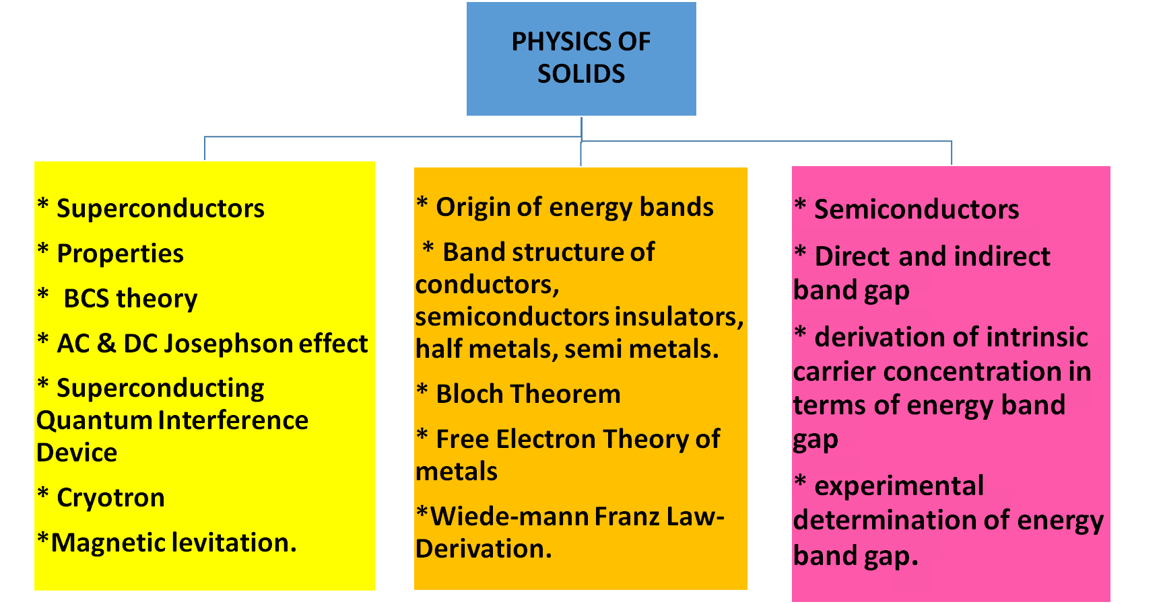

Slide 4


Slide 5
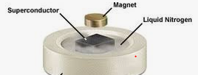
Superconductivity / Superconductors
Superconductivity is the ability of certain materials to conduct electric current with approximately zero resistance at and below the critical (transition) temperature. The corresponding materials are called superconductors.
Superconductivity was first observed in 1911 by H. K. Onnes, a Dutch physicist. His experiment was conducted with elemental mercury at 4 degrees kelvin.
2 Marks

Slide 6
Superconducting Materials
Questions
Analyze the Properties of Superconductors
2. Enlighten the Overview theories about Superconductivity
3. Elucidate the Applications of Superconductors

Slide 7


Slide 8
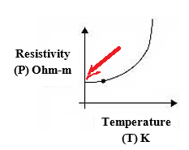
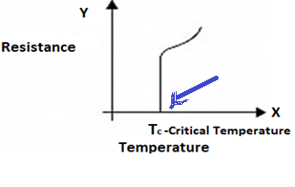
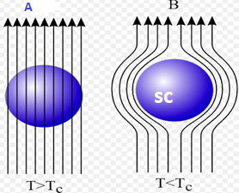
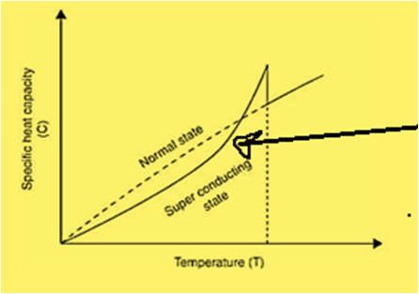
Properties of Superconductors (approx. Zero Resistance Materials)
Zero Electrical Resistance
Diamagnetic Property (Meissner Effect)
2 Marks
Normal Conductor
Super Conductor
R _{Super conductor} / R _{Normal conductor} < 10⁻⁵
R _{Super conductor} < 10⁻⁵ (R _{Normal conductor})
Discontinuous Change in C
Transition Temperature/ Superconducting materials
The electrical resistivity of the material abruptly drops to zero.
The magnetic flux lines are excluded from the material.
There is a discontinuous change in specific heat capacity (C).
There are small change in thermal conductivity and volume of the material.
B=0

Slide 9
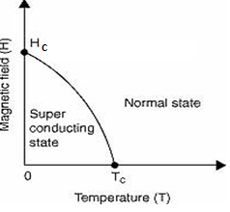
Diamagnetic property (Magnetic susceptibility is negative) (or)
Show how the superconductors are perfect diamagnet
Magnetic flux density inside the material = B = μ₀ (H+I)
Here, magnetic flux density inside the superconductor = B = 0
Hence μ₀ (H+I) = 0
μ₀ is the permeability of free space = constant, So μ₀ ≠ 0
Then (H+I) = 0 and H = - I
Magnetic susceptibility of the superconductor = χ_{m} = (I/H) = I/(-I) = (-1)
Hence Superconductors are perfect diamagnet
Effect of Heavy Magnetic Field
Effect of Heavy Current (Silsbee’s rule) /Critical Current (IC)
When heavy current flows through a superconductor it will set up the magnetic field which destroys the superconducting property of the superconductor.
I_{c}= 2πrH_{c}
r- Radius of superconducting wire
H_{c} = H₀ [1 – (T² / Tc²)]
where,
H₀ is the critical field at 0 K,
T is the temperature of the material
T_{c} is the transition temperature

Slide 10
Possible Problems
The critical values of magnetic field for niobium are 2 x 10⁵ A/m (H0 ) and 10⁵ (Hc) A/m at 0 K and 8 K respectively. Determine its critical temperature.
Sol: WKT H_{C} = H₀ [1 – (T / T_{C}) ²]
Hence T_{C} = T / [1 – (H_{C} / H₀)] ^{½}
Here, we have
H₀ = 2 X10⁵ A/m, H_{C} = 10⁵ A/m, T = 8 K
T_{C} = 8 / [1- (10⁵ / 2 x 10⁵)] ^{½}
T_{C} = 11.312 K
Determine the critical current that can flow through a long thin superconducting wire of aluminium of diameter (2r) 10⁻³ m. The critical magnetic field (Hc) for aluminium is 7.9 x 10³ A/m
Sol: WKT I_{C} = 2πrH_{c}
Here, we have
H_{C} = 7.9 X 10³ A/m, 2r = 10⁻³ m
I_{C} = 3.14 X 10⁻³ X 7.9 x 10³
I_{C} = 24.806 A.

Slide 11
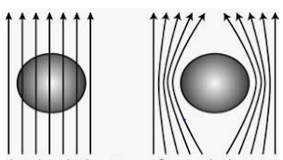

Skin Effect, London Penetration depth and Fluxon – Possible problems
Skin Effect
In the superconducting state, superconductor expels the magnetic flux. Hence, DC current flows only over the outer surface of the superconductor. This effect is called Skin effect.
In Application of magnetic field
London Penetration depth
The applied magnetic field penetrates some distance into the superconductor. This distance is called London Penetration depth (λ).
(λ_{T} / λ_{o})²= 1 / [1 – (T/T_{c})⁴]
where λ_{T} and λ_{o} are the penetration depth at T K and 0 K.
Normal
conductor
Super
Conductor
(Initially)
Super
Conductor
(after some time by application of Magnetic Field)
Fluxon Or Flux Quantisation
The magnetic flux ф through a superconducting ring is quantized in terms of h/2e. This phenomenon is said to be flux quantization. This fundamental quantum of flux is called Fluxon (ф_{o}).
ф_{o} = (h/2e) = [6.626 x 10 ⁻³⁴ /(2 x 1.602 x10⁻¹⁹)] = 2.068 x 10⁻¹⁵ Weber.
The magnetic flux enclosed by a superconducting ring is ф = n ф_{o} = n (h/2e).
2 Marks

Slide 12
Problem
Coherence Length (ξ):
The paired electrons (Cooper pairs) are not scattered because of their peculiar properties of smoothly riding imperfection. Also there is no exchange of energy between them. Mean time, they can maintain their coupled motion up to certain distance (about 10⁻⁶ m). This distance is called Coherence Length
Calculate the London penetration depth for lead at 5.2 K (T) if the penetration depth at 0 K is 37 nm (λo). The critical temperature of lead is 7.193 K (T_{C}).
Sol.
WKT (λ_{T} / λ_{o}) = [1 – (T/Tc)⁴]^{-1/2}
Hence, λ_{T} = λo [1 – (T/Tc)⁴]^{-1/2}
Here, we have
λo = 37 nm, T_{C} = 7.193 K and T = 5.2 K
λ_{T} = 37 [ 1- ( 5.2/7.193)⁴]^{-1/2}
λ_{T} = 43.4 nm.
Ginzburg Landau Parameter (k):
It is the ratio of London penetration depth (λ) to coherence length (ξ). k = λ/ξ.
If k < (1/√2), the material is type I superconductors (soft / temporary Superconductor)
if k > (1/√2), the material is type II superconductors (Hard Superconductor).

Slide 13
Other Properties
Effect of Pressure
Some materials which behave as normal conductors at normal pressure can undergo phase transition and behave as superconductors under the application of external pressure. e.g.
Example: Silicon becomes a superconductor at 165 kilo bar pressure and
its T_{c} = 8.3 K
Effect of Isotope
The transition temperature of the given superconducting material varies with its mass number (M) or isotopic mass and this effect is known as Isotope effect.
T_{c} ∝ [1 / M^{½}]
For e.g. Mass number of mercury varies from 199.5 to 203.4 a.m.u and the corresponding transition temperature T_{c} varies from 4.185 to 4.146 K respectively
Effect of Impurity
The magnetic properties of the superconductors are modifies by the addition of impurities.
Entropy:
Entropy is a measure of degree of dis orderness of the given system. The entropy of a superconducting material is found to be lower than that of the normal conducting material which indicates that in the superconducting state the electrons are in the more ordered state than they are in the normal conducting state.

Slide 14

London’s Theory (Macroscopic)
The BCS Theory (Microscopic) /
Bardeen Cooper Schrieffer Theory

Slide 15
BCS Theory Outline
Electron- Phonon – Electron interaction
Cooper Pair of Electrons
Coherence Length
Effect of Temperature
Major accomplishments of BCS theory

Slide 16

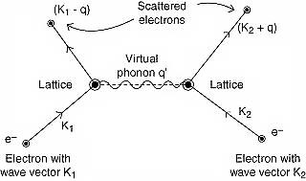
Electron-Lattice- Electron (Electron-(Phonon)- Electron) Interaction & Cooper pair Formation
Total wave vector before interaction = Total wave vector after interaction
K₁ + K₂ = (K₁ - q) + (K₂ + q) = K₁ + K₂
Coherence Length (ξ) – ref Slide 10

Slide 17
Effect of Temperature
Binding Energy
The energy of the Cooper pair (E_{cp}) is less than the total energy of separated electrons (E_{sep}) in the normal state.
(E_{cp} < E_{sep})
So the Binding Energy (B.E) of the Cooper pair (E) is the energy difference between the normal state and paired state
B.E = E_{sep -} E_{cp}
Also this energy is required to break the Cooper pair.
At T > T_{c} , all the free electrons are in the separated position (NC).
At T < T_{c}, electron-lattice-electron interaction is stronger than electron-electron repulsive coulomb interaction. So the free electrons tend to pair up (formation of Cooper pair) (SC) .
Major accomplishments of BCS theory
BCS theory explained Meissner effect, coherence length, penetration depth, flux quantization and energy gap parameter.
It gives the expression for the transition temperature (McMillan’s formula)
2 Marks

Slide 18
Applications of Superconductors
MAGLEV (Magnetically Levitatated train)
Cryotron (Magnetically operated relay switch)
Josephson Effect (AC and DC)
SQUID (Superconducting Quantum Interference Device)

Slide 19
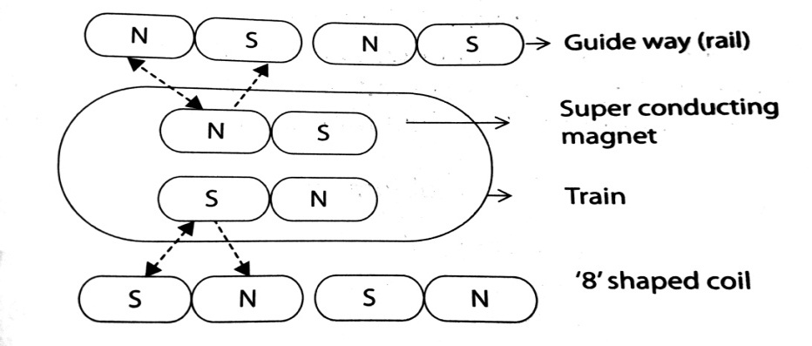
MAGLEV (Magnetically Levitated train)
Working:
Principle : Meissner Effect and Electro magnetic Induction
Initially the train slide on the rails.
When the train moves, the superconducting magnets on each side of the train will induce a current in the “8” shaped coils kept in the guide way.
This induced current generates a magnetic force in the coils in such a way that, the lower half of the “8” shaped coil has the same magnetic pole as that of the superconducting magnet in the train, while the upper half has the opposite magnetic pole.
Hence, the total upward magnetic force acts on the train and the train is levitated or raised above the wheels. Now the train floats in the air. By an alternatively changing the poles of the superconducting magnets in the train, alternating currents can be induced in the “8” shaped coils.
Thus alternating series of north and south magnetic poles are produced in the coils, which pulls and pushes the superconducting magnets in the train and hence the train is further moved.
Because of no mechanical friction, speeds up to 500 Km/hr can be easily achieved.
Construction: Diagram and explanation

Slide 20
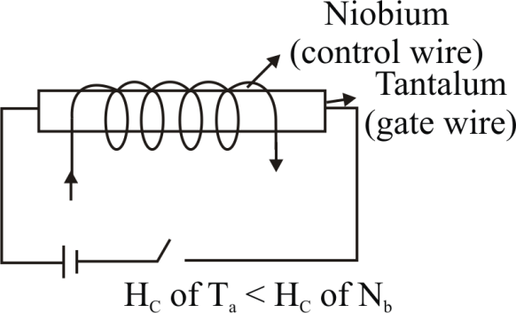
Cryotron (Magnetically operated relay switch)
Principle :
Superconductivity will be destroyed , When T > TC
Construction : Diagram and Explanation
Working :
(Explain how it acts as a relay switching element)
At an operating temperature, the magnetic field produced by the superconducting material Niobium-Nb may exceed the critical field of Tantalum–Ta.
Hence, the superconducting material Tantalum–Ta becomes normal conductor since the critical field of Tantalum–Ta is less than the critical field of Niobium-Nb.
But Niobium-Nb will not become normal conductor.
Hence, the current in material Ta can be controlled by the current in Niobium-Nb and the system can acts as a relay or switching element.

Slide 21
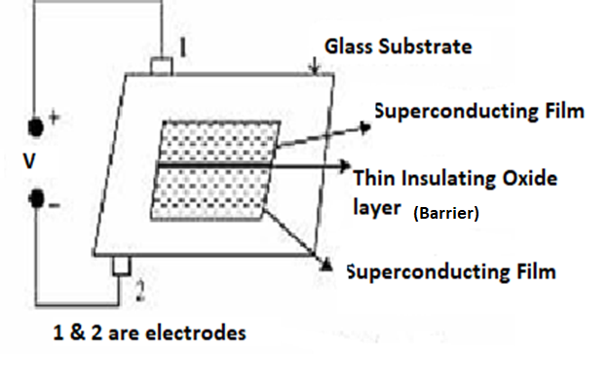
JOSEPHSON EFFECT
D.C. Josephson Effect
In a Josephson junction, in the absence of any external electric field across the barrier, there will be tunnelling of electrons from one superconducting film of higher electron density to the other superconducting film of lower electron density.
This tunnelling of electrons results in a dc voltage across the barrier. This effect is called D.C Josephson effect.
A.C. Josephson Effect
When a constant nonzero potential (V) is maintained across the barrier of the Josephson junction, an alternating super current flows through the barrier in addition to the dc current. This phenomenon is known as ac Josephson Effect
Josephson Junction

Slide 22
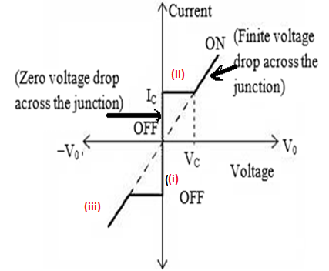
I-V Characteristics of Josephson junction
Let V₀ be the applied dc potential and V_{c} be the minimum dc potential required to produce ac Josephson effect.
When V₀ = 0, there is a constant dc current (i_{c}) flows through the junction. ( DC Josephson effect)
When V₀ < V_{c}, again we have only the constant dc current flows through the junction.
(During the conversion of dc to ac, the cooper pairs are separated into single electrons with the help of an applied dc voltage and the time interval is about 10⁻¹¹ sec. In this short period, there is no current flow across the junction).
(iii) When V₀ > V_{c,} the junction has finite resistance and the current oscillates with an frequency by υ = 2eV₀/ h (AC Josephson effect)

Slide 23
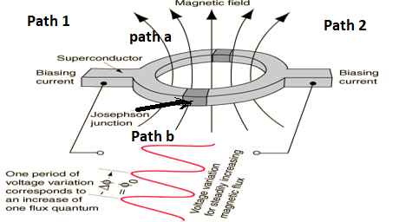
SQUID
(Also can be asked as application of Josephson Effect)
Principle:
A small change in magnetic field produces variation in the flux quantum.
Construction: Diagram and Explanation
Working :
Final result from derivation,
Total current along the path 2 is I_{T} = I_{a} +I_{b}
= Io {sin[δ₀ – (πΦ/Φ₀)] + Sin[δ₀ + (πΦ/Φ₀)]}
= 2 I₀ sinδ₀ cos(πΦ/Φ₀)
This equation represents the interference of the two coherent super currents flowing along the paths 1 and 2.
I_{T} varies with cos(πΦ/Φ₀) and the condition for current maxima is (πΦ/Φ₀)= π, 2π, 3π, 4π, etc. So current maxima occurs by the magnetic flux increases by a fluxon. (Φ = nΦ₀) [ refer slide no. 9]
Applications
SQUID is used to detect very tiny magnetic field and hence it is used as a magnetometer.
MRI (Magnetic Resonance Imaging) scanning, employing SQUID, is used to measure the field in the micro Tesla region, where as the ordinary MRI is used to measure the field from one to several Tesla.
Based on these sensors we have, magnetocardiography (MCA), Magneto encephalography (MEG), etc.

Slide 24
Derivation
The super current along the path 1 is represented by a wave function with a phase angle is
I = I₀ sinδ₀
where I₀ is the maximum current and δo is the initial phase angle.
Current along the path a is I_{a} = I₀ sinδ_{a} = I₀ sin[δ₀ – (πΦ/Φ₀)]
Current along the path b is I_{b} = I₀ sinδ_{b} = I₀ sin[δ₀ + (πΦ/Φ₀)]
where δ_{a} and δ_{b} are the phase difference between the paths 1&a and 1&b respectively. Φ is the external applied flux. Φ₀ is fluxon.
In the absence of applied magnetic field (B = 0), phase difference is zero (δ_{b} – δ_{a} = 0). In the presence of applied magnetic field (B ≠ 0), phase difference is not zero (δ_{b} – δ_{a} ≠ 0) ( δ_{b} – δ_{a} = 2πΦ/Φo)
Total current along the path 2 is = I_{a} +I_{b}
= Io {sin[δ₀ – (πΦ/Φ₀)] + Sin[δ₀ + (πΦ/Φ₀)]}
I_{T} = 2 I₀ sinδ₀ cos(πΦ/Φ₀) [ Sin (A-B) + Sin (A-B) = 2 Sin A Cos B]

Slide 25
Can You Try ?????
The Material reaches superconductivity at and below / above Critical temperature.
The Superconductors are Perfect Dia magnet / Ferro Magnet.
The Magnetic flux lines are attracted / repelled by a superconductor.
The Magnetic Susceptibility is negative /Positive in a Dia magnet.
Meissner effect is the principle of Maglev / Cryotron.
The same / different energy is required to form and to break cooper pair of electrons.
The distance penetrated by the magnetic field into the superconductor is called as ______
London Penetration Depth
A small change in magnetic field produces _______ in SQUID
Flux Quantisation
In Josepson Effect the time interval ____ is taken to separate cooper pair of electrons
10⁻¹¹ sec
In cryotron the -------- wire has much Hc
control

Slide 26
Part A
Define superconductivity.
What are superconductors?
Define transition temperature of the superconductor.
Write short note on occurrence of superconductivity.
List out some important physical changes in material that occur at Tc.
Explain the formation of cooper pair.
What is superconducting energy gap?
Define coherence length.
What do you mean by persistent current?
State and explain Meissner effect with diagram.
Prove that superconductor is a perfect diamagnet
What do you mean by critical magnetic field of a superconductor?
How it varies with temperature? 46. What is Silsbee’s rule?
.

Slide 27
Define penetration depth of a superconductor.
What is isotope effect on super conductor
How the entropy of superconductor varies with temperature
Write a note on specific heat capacity of superconductors
Differentiate energy gap of superconductor from semiconductor.
What is skin effect?
What do you mean by flux quantization?
List out the major accomplishments of BCS theory.
What is Ginzburg Landau Parameter? Mention its significance
What is the effect of pressure on materials? List out applications of Josephson’s device.
What is Magnetic levitation and explain the function of Maglev train.
Define fluxon and fluxoid
What is a cryotron and why it is called so?
What is SQUIDS and mention its uses.
How can you generate microwaves using Josephson device?
Explain the IV characteristics of Josephson current?
Sketch the diagram for Josephson device? Explain with diagram.
Explain DC and AC Josephson effects.

Slide 28
Band Theory of Solids

Slide 29
Structure of solids - Origin of energy bands, band structure of conductors, semiconductors , insulators, half metals, semi metals
Fermi level, Fermi surface, density of states
Bloch Theorem
Free Electron Theory of metals
Wiede-mann Franz Law- Derivation

Slide 30

Origin of energy bands
If ‘N’ number of atoms are brought together to form a solid and if these atoms’ electrons interact and give ‘N’ number of closely spaced energy levels in the place of discrete energy levels, it is known as bands of allowed energies/band.
Between the bands of allowed energies, a small region does not allow any energy levels.
Such regions are called forbidden energy band/ energy gap (E_{g}).
The allowed bands of energies and forbidden bands of energies are present alternatively one after another for the electrons of a solid.

Slide 31
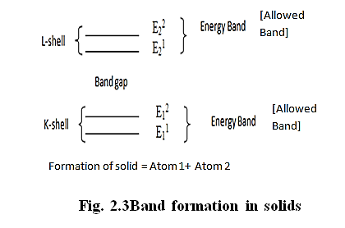

Slide 32
When two atoms of equal energy levels are brought closer together, the k shell energy levels of individual atoms lie in the energy level E₁ and splits into E₁¹ and E₁² become as energy band.
Similarly for L-shell energy levels lies in the energy level E₂ and splits into E₂¹ and E₂².
Similarly when three atoms are brought together, the energy levels are in K – shell and L-shell are E₁¹ , E₁² and E₂¹, E₂² respectively.
Similarly for K, L,M and N shells are E₁¹ , E₁²,E₁³ , E₁⁴ and E₂¹, E₂², E₂³, E₂⁴ respectively.
These type of transformations from the original energy levels into two (or) more energy levels is known as energy level splitting.

Slide 33
In example Lithium atom consists of 3 electrons.
Among them the two electrons are in the same energy state (1s) and the other one is in the higher energy state (2s).
In a solid of lithium contains N number of atoms, the lower energy level forms a band of 2N electrons occupying N different energy levels are shown in Fig.
The higher energy level can form a band of 2N electrons (completely filled). But only N numbers of electrons are present in the next energy level. Therefore the band is half-filled band.
The unoccupied band of the solid corresponds to the un occupied excitation level of the isolated atom.

Slide 34
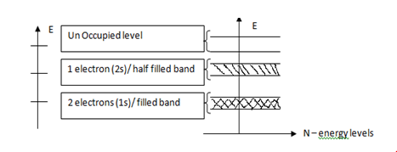
The electrons in lower filled energy (closely bounded with nucleus) band do not have any freedom to move in the crystal.
The electrons in half filled energy level (loosely bound with nucleus) are free to move inside the crystal. Generally the half-filled band is called valence band
Upper unoccupied (unfilled) band is called conduction band.
In between the valence band and conduction the gap is known as energy gap

Slide 35
The differences between metals, semiconductors and insulators can be made based on
(i) the width of the energy gap
(ii) number of effective electrons (The availability of number of free electrons that participate in electrical conduction per unit volume when an electric field is applied. These free electrons are called effective electrons).

Slide 36
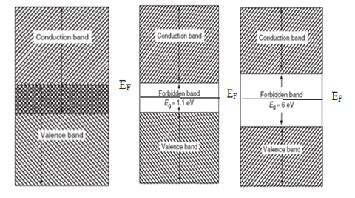
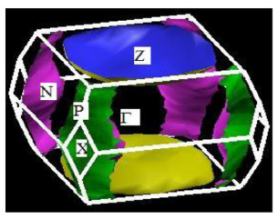
BAND STRUCTURE OF CONDUCTOR, SEMICONDUCTORS, INSULATORS
The Fermi surface is defined as the surface of constant energy 𝐸_{𝐹} in K- space inside which all the states are occupied by the valence electron.
The shape of the Fermi surface is determined by the geometry of the energy contours in a zone.
A study of the shape of the Fermi surface and its
proximity of the Brillouin zone is used to determine the properties of solids, such
as heat capacity, pauli’s paramagnetism , electrical conductivity etc.
At absolute zero (0K) the energy levels are completely occupied by electrons up to a certain level. Above that the energy levels are completely unoccupied by electrons. This highest level which is completely filled by electrons is called Fermi level.
The Fermi energy (E_{F}) is described as the highest energy that the electrons assumes at a temperature of 0 K

Slide 37
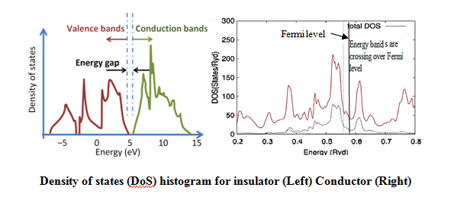

Density of states (DoS)

Slide 38
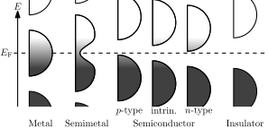
Semi Metal and Half Metal
“semi­metal,” energy bands over­lap slightly at the Fermi level (shown in Fig.).
The semi­met­als are met­als.
Semi­metals have properties intermediate be­tween met­als and semi­conductors.
A half-metal is any substance that acts as a conductor to electrons of one spin orientation, but as an insulator or semiconductor to those of the opposite orientation. Although all half-metals are ferromagnetic types but all ferromagnets are not half-metals.

Slide 39
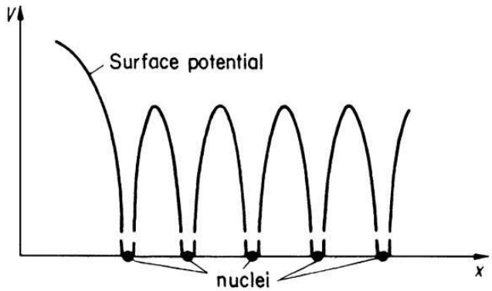
BLOCH THEOREM
Based on band theory, the solids are again classified into conductor, semiconductor and insulator.
In order to understand the difference between the conductors and insulators, it is necessary to incorporate the variation of potential inside the crystal due to the presence of positive ion cores in the free electron model.
It gives the realistic idea about to assume the potential inside the metallic crystal to be periodic with the periodicity of the lattice shown in Fig.
Fig. One dimensional periodic potential in a crystal

Slide 40

An electron passes along X-direction in a one-dimensional crystal having periodic potentials:
V(x) = V (x + a)
where ‘a’ is the periodicity of the potential.
The Schrödinger wave equation for the moving electron in a constant potential (V) is:

Slide 41
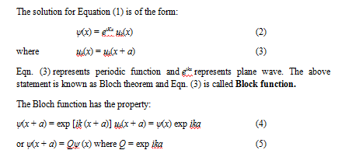

Slide 42
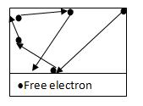
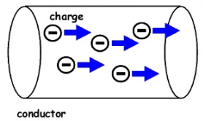
Classical free electron theory of metals
The classical free electron theory was introduced by P. Drude in 1900 and developed by Lorentz in 1909 to explain electrical conduction in metals.
This theory has some assumptions / Postulates; they are:
The valence electrons of metallic atoms are free to move in the spaces between ions from one place to another place within the metallic specimen similar to gaseous molecules so that these electrons are called free electron gas. These electrons also participate in electrical conduction; hence they are called conduction electrons.
There is no interaction between these conduction electrons.
The interaction of free electrons with ion cores is negligible.
The free electrons find uniform electric field of positive ions and that of electrons in the metal.
Since the electrons are assumed to be a perfect gas they obey classical kinetic theory of gasses.
Classical free electrons in the metal obey Maxwell-Boltzmann statistics.

Slide 43
Merits of classical free electron theory:
Classical theory successfully explains electrical and thermal conductivities of metals, the increase of resistance with temperature, opacity, luster, etc.,
It verifies Ohm’s law
It is used to derive Wiedemann Franz law
It is also used to explain optical properties
Drawbacks of classical free electron theory:
It is a macroscopic theory
There is an controversy in Classical theory and quantum theory; Classical theory states that all free electrons will absorb energy but quantum theory states that only few electron will absorb energy.
This theory cannot explain the Compton effect , photo electric effect and about magnetism.
The theoretical and experimental electronic specific heat value is not agreed well.
The Lorentz number is mismatched in classical theory and it is rectified in quantum theory.

Slide 44
Basic definitions
Drift velocity (v_{d}): It is defined as the average velocity acquired by the free electron in a particular direction due to the application of electric field.
Relaxation time (τ): It is the time taken by the free electron to reach its equilibrium position from its disturbed position in the presence of applied field.
Collision time (τ_{c}): It is the average time taken by a free electron between two successive collisions.
Mean free path (λ): The average distance travelled between two successive collisions is called mean free path

Slide 45
Wiedemann Franz law.pdf
Wiedemann Franz law.pdf

Slide 46
Classical free electron theory of metals
Quantum free electron theory of metals
Band theory of metals (or) Brillouin zone theory

Slide 47
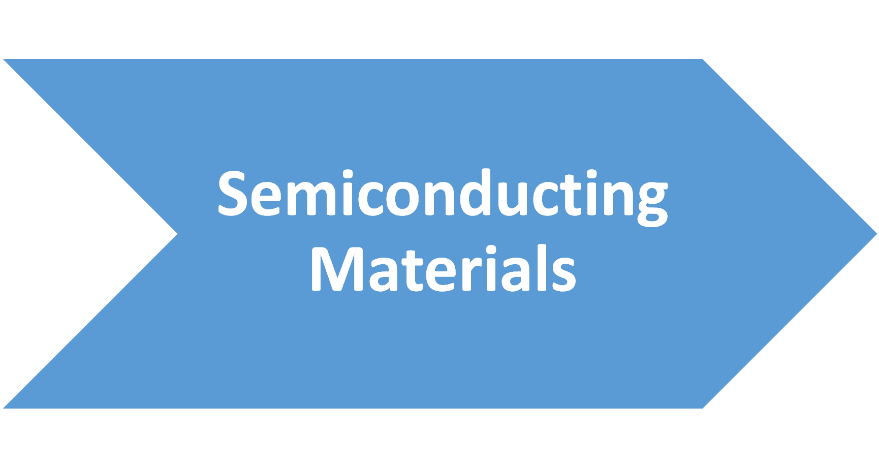

Slide 48
* Direct and indirect band gap Semiconductors
* Experimental determination of energy band gap.
* Derivation of intrinsic carrier concentration in terms of energy band gap

Slide 49
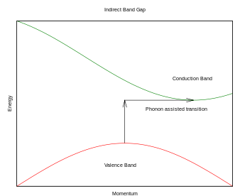
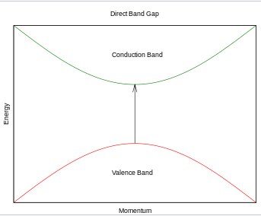
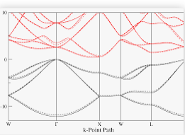
 | Direct Band gap semiconductor | Indirect Band gap semiconductor
In semiconductor physics, the band gap of a semiconductor can be of two basic types, a direct band gap or an indirect band gap.
 | The minimal-energy state in the conduction band and the maximal-energy state in the valence band are meet at same k-point An electron can directly emit a photon Applications:optical devices such as LEDs and semiconductor lasers | The minimal-energy state in the conduction band and the maximal-energy state in the valence band are not meet at same k-point In an "indirect" gap, a photon cannot be emitted because the electron must pass through an intermediate state and transfer momentum to the crystal lattice. Applications:absorbers in solar cells etc.

Slide 50
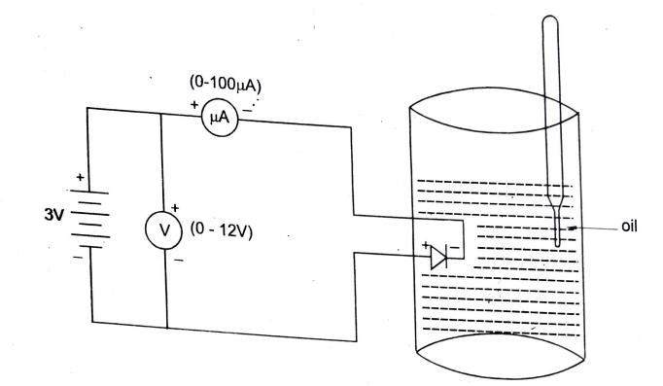
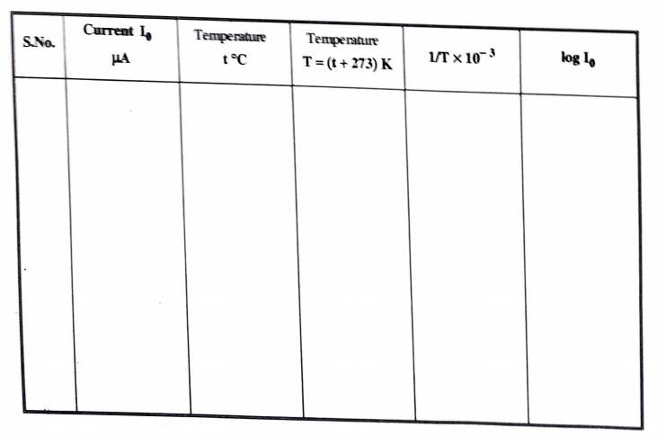
Experimental determination of energy band gap.
Circuit
Table

Slide 51
Experimental Procedure
The diode is immersed in an oil bath that in turn is kept in a heating mantle.
A thermometer is also kept in the oil path such that its measure bulb is just at the height of diode.
The diode is reversed biased with the help of DC voltage obtained from a DC power supply and the current that flows through the reverse diode is measured with a milliammeter.
The power supply is switched on and the voltage is adjusting say five volts. The current through the diode and the room temperature are noted. The power supply in switched off and the heating mantle is switched on. The oil bath is heated up to 65⁰ C. The oil is stirred well. The temperature of oil bath stabilized say at 75⁰ C.
The power supply is again switched on and the voltage is kept at 5V. The temperature (say 75⁰C) and the corresponding current through the diode are noted.

Slide 52
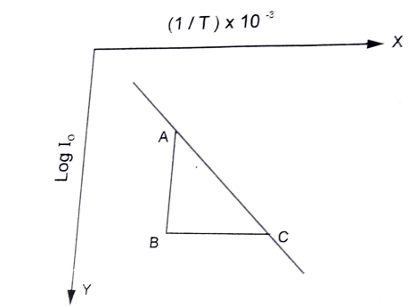
Now the oil bath is allowed to cool slowly. As the temperature falls, the current through the diode decreases. The current falls for various temperatures (any convenient interval) are noted down. (refer graph in Figure )
The slope of the straight line is determined and using it the band gap is calculated using the following equation.
E_{g} = 3.973x10⁻⁴ x slope eV
(slope = AB/BC)

Slide 53
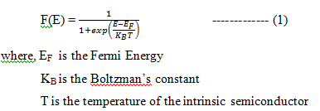
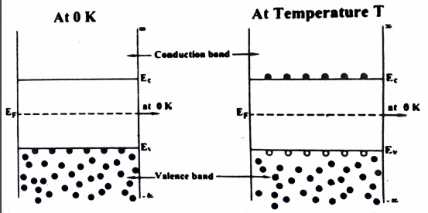
Derivation of intrinsic carrier concentration in terms of energy band gap
At absolute zero temperature, the valence band is completely occupies by electrons but the conduction band is completely empty. The completely filled band does not conduct current.
At finite temperature, the electrons in the valence band get excited and they will move to the conduction band. So holes are produced in the valence band. The probability of occupation of electrons in the conduction band and holes in the valence band are described by the Fermi distribution function .i.e..,

Slide 54


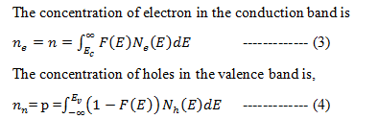
Derivation for Electron Concentration of Intrinsic Semiconductor
For electrons at the bottom of the conduction band
Hence, (ref. 1) eqn. 1 can be modified as,
Hence 1 + exp (x) = exp (x)

Slide 55

Where, N_{e}(E) is the electron density (number of electrons per unit volume) of states near the conduction band
N_{h} (E) is the hole density of states near the valence band.
The electron density of states in the conduction band is
Where m_{e}* is the effective mass of electron in conduction band.
Substituting equations (2) and (5) in equation (3), we get,
Assume that,
and
E = xK_{B}T + E_{c}
Differentiating the above equation, we get, dE = K_{B}T.dx

Slide 56


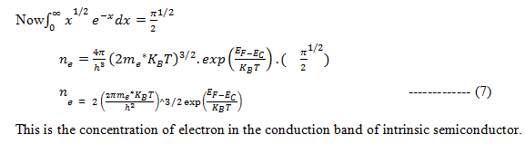
Substitute the above assumption in equation 6,
Because,
E = xK_{B}T + E_{c}

Slide 57

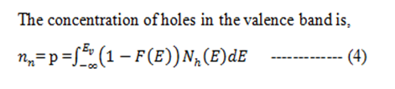

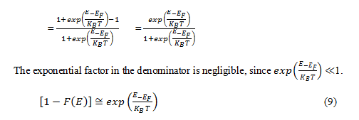
Derivation for Hole Concentration of Intrinsic Semiconductor
F (E) represents the probability of filled state. Hence the probability of unfilled state is [1 – F (E)]. Because the maximum probability will be 1
Refer eqn. 1 and 4

Slide 58
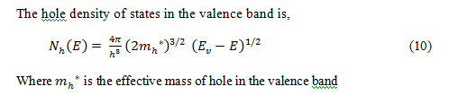

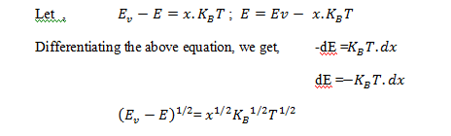
Substituting equation (9) and (10) in equation (4), we get,

Slide 59




Because,
E = E_{v} - xK_{B}T
To exclude – ve sign limits are interchanged
------ (12)

Slide 60
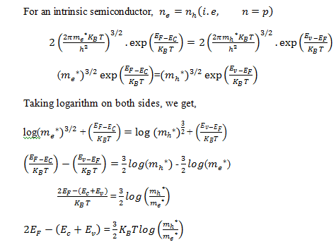
Expression of Energy gap - E_{g} in Intrinsic semiconductor

Slide 61
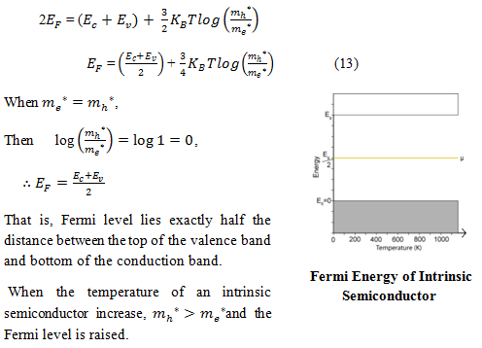

Slide 62


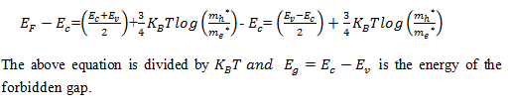
CARRIER (ELECTRON AND HOLE) CONCENTRATION OF INTRINSIC SEMICONDUCTOR IN TERMS OF BAND GAP ENERGY
Take equation (7)
Sub. (13 ) in second term of (7)
Where,

Slide 63
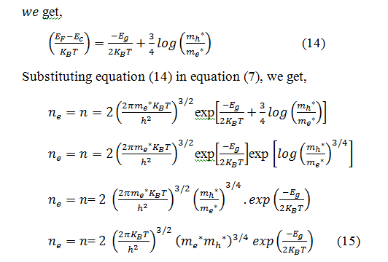

Similarly for holes, by using equation (12),
Equations (15) and (16) gives intrinsic charge carrier concentration in terms of Energy gap.

Slide 64
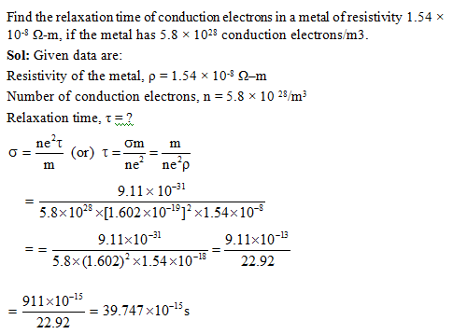
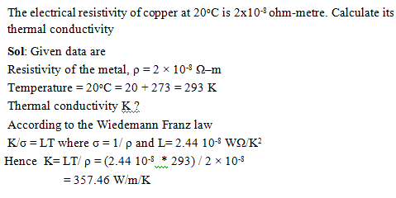
Problems

Slide 65
Part A
Write some merits of free electron theory
Write few drawbacks of classical free electron theory
How quantum is better than classical free electron theory
Write about zone theory
State Wiedemann Franz law Define drift velocity
Define collision time
Define mean free path
Define relaxation time
Compare classical and quantum free electron theory
Differentiate conductor, semiconductor and insulator.
Explain briefly about the types of semiconductor.
What do you meant by intrinsic semiconductor?
Differentiate crystalline and non-crystalline solids
How the bands are formed in a solid
What is allowed band and forbidden band
Draw the band formation diagram
Differentiate metal, half metal and semi metal
Differentiate conductor and insulator
Explain types of semiconductor based on energy band theory
How Fermi level play a role in p-type and n-type semiconductor
Explain Fermi surface
Explain Fermi energy
Explain Fermi level
Explain density of states with respect to Fermi level
Explain the effect of external field on Fermi surface

Slide 66
Part B
State and derive Wiedemann Franz law
Explain band theory. Differentiate conductor, semiconductor and insulator based on band theory.
Elaborate Free electron theory with their merits and demerits
Define intrinsic semiconductor. Derive an equation of electron and hole concentration of an intrinsic semiconductor.
Define Band gap. Explain the determination of band gap of a semiconductor.

